Slide 1
Reflections
Reflections

Slide 2
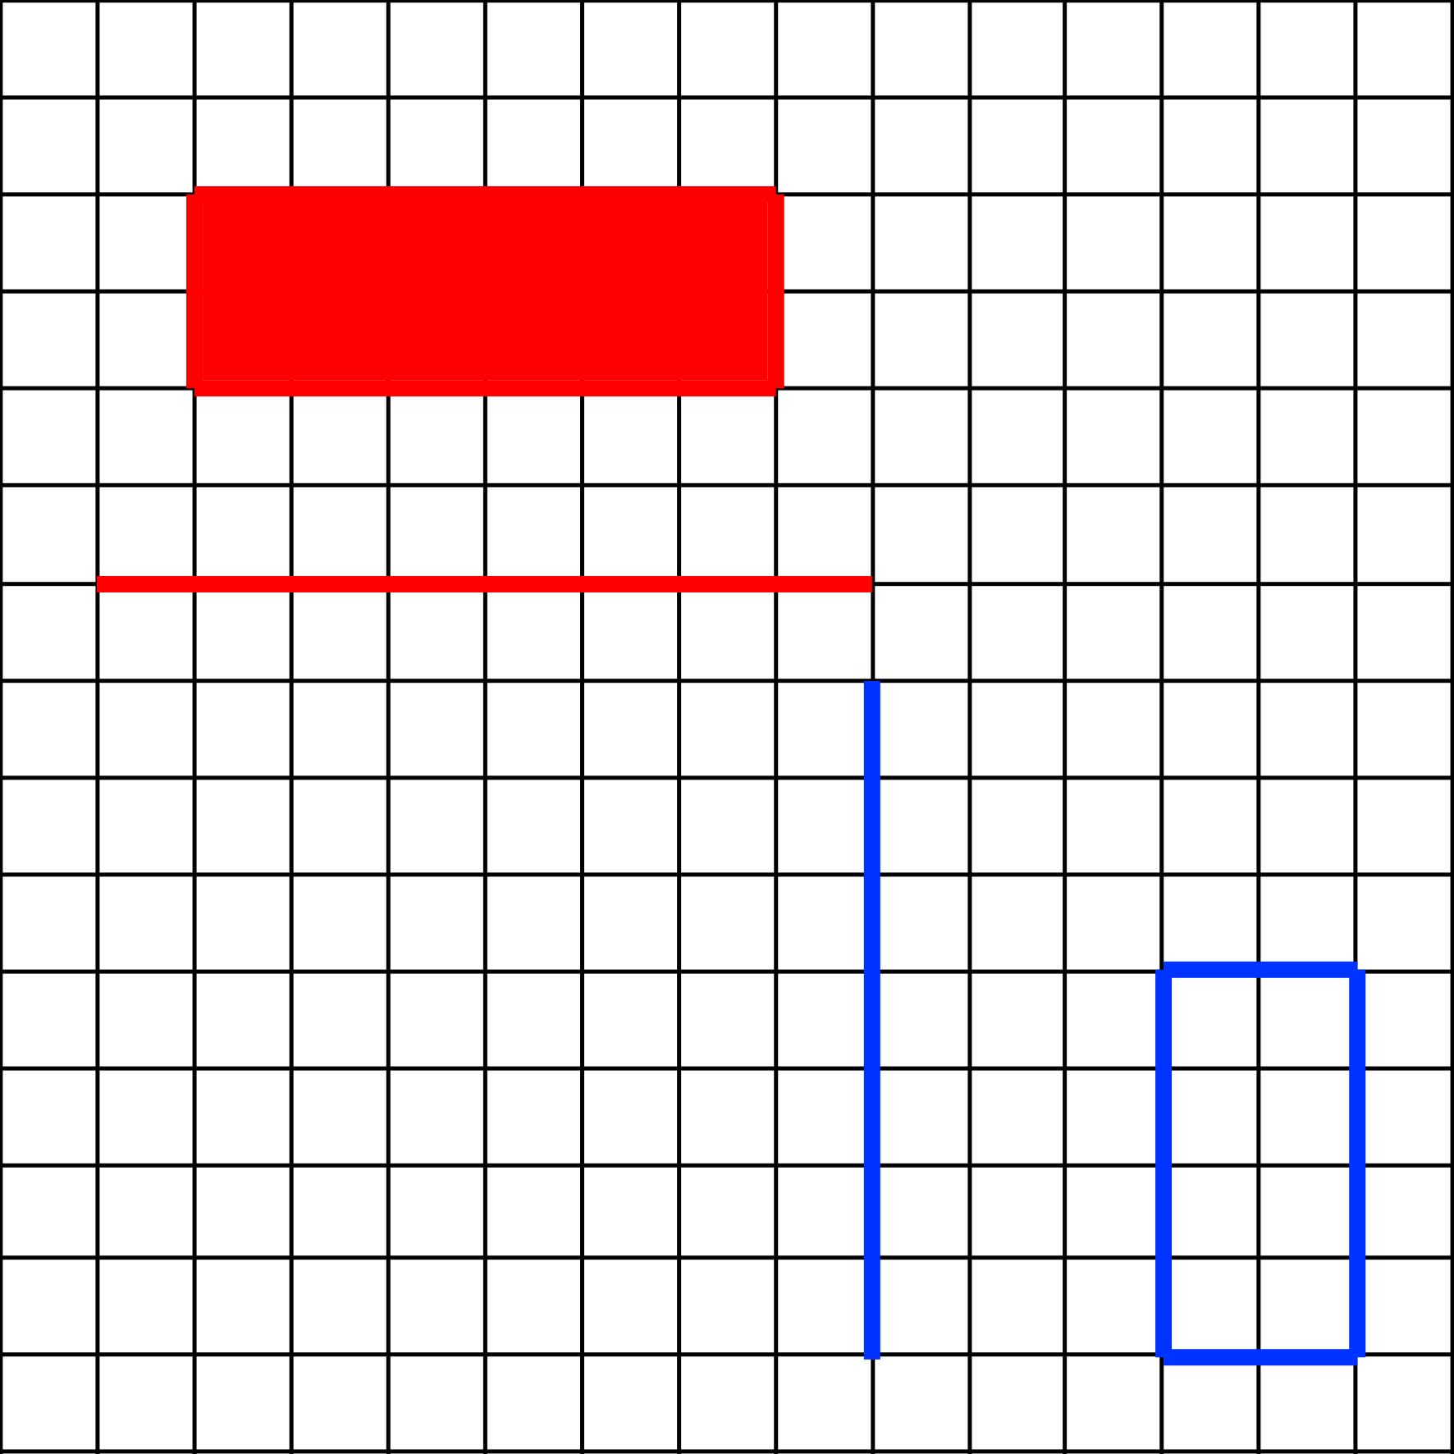
What letter would you get if you reflected each shape in its corresponding mirror line?

Slide 3
What letter would you get if you reflected each shape in its corresponding mirror line?

Slide 4
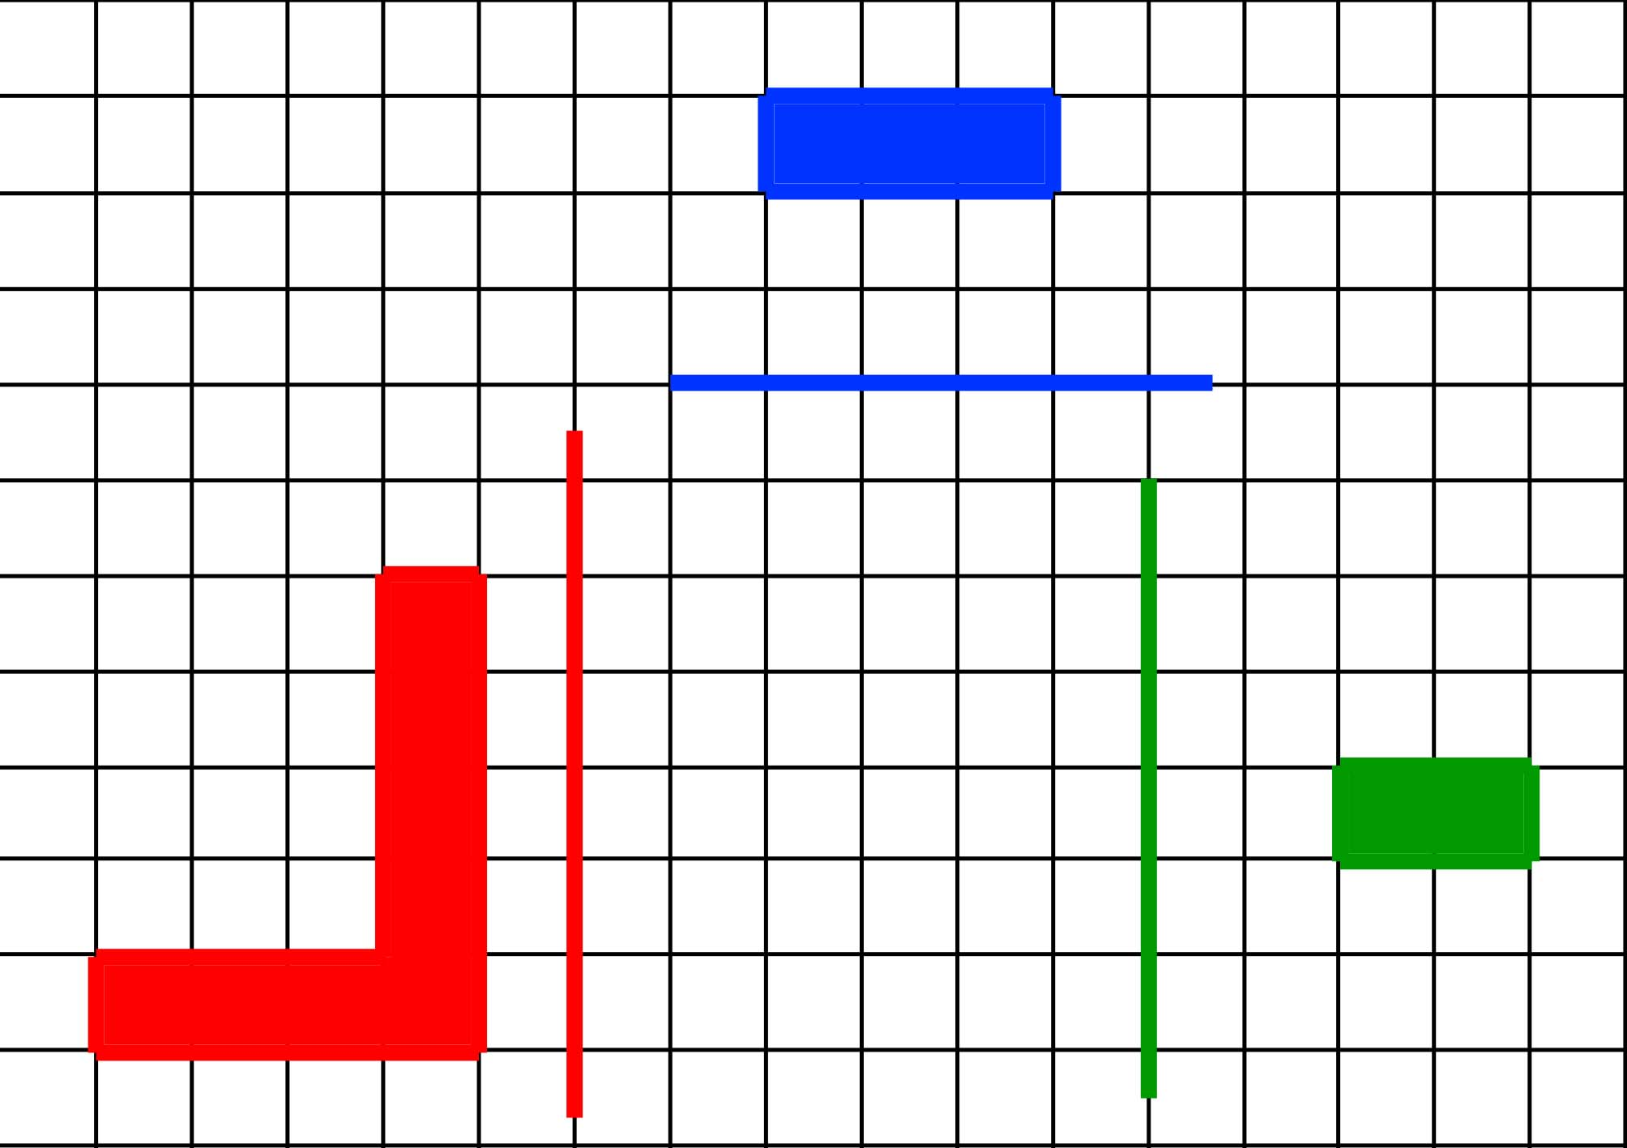
What letter would you get if you reflected each shape in its corresponding mirror line?

Slide 5
What letter would you get if you reflected each shape in its corresponding mirror line?

Slide 6
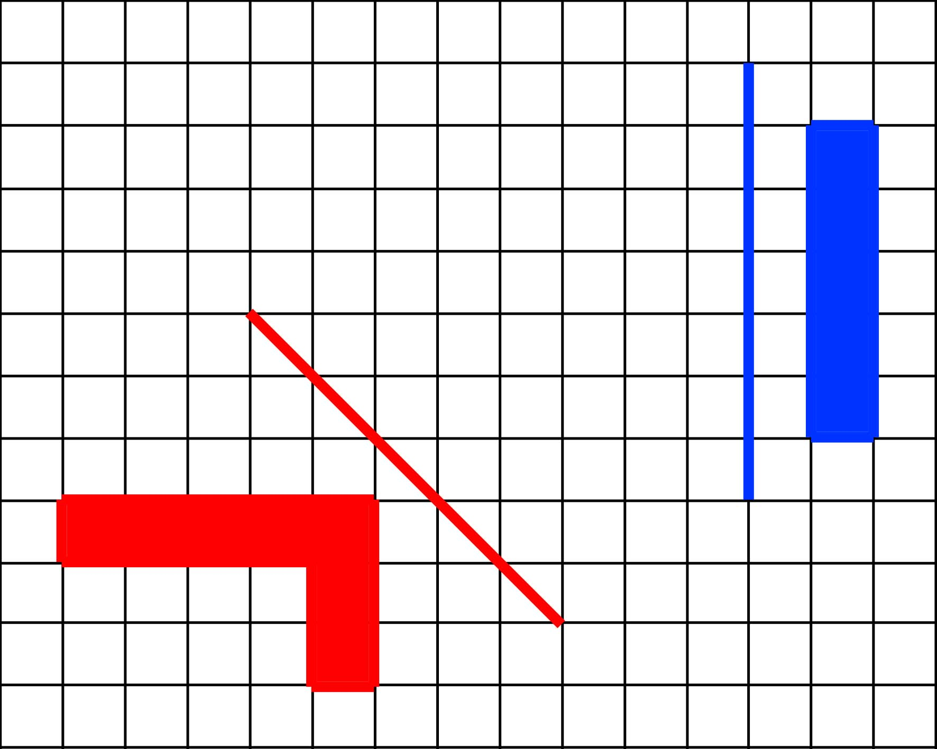
What letter would you get if you reflected each shape in its corresponding mirror line?

Slide 7
What letter would you get if you reflected each shape in its corresponding mirror line?

Slide 8
Now it’s your turn…
On your worksheet, reflect every shape in the corresponding mirror line.
Use tracing paper to help you.
All the shapes should fit together to form a word.
Draw in pencil in case you make any mistakes.

Slide 9
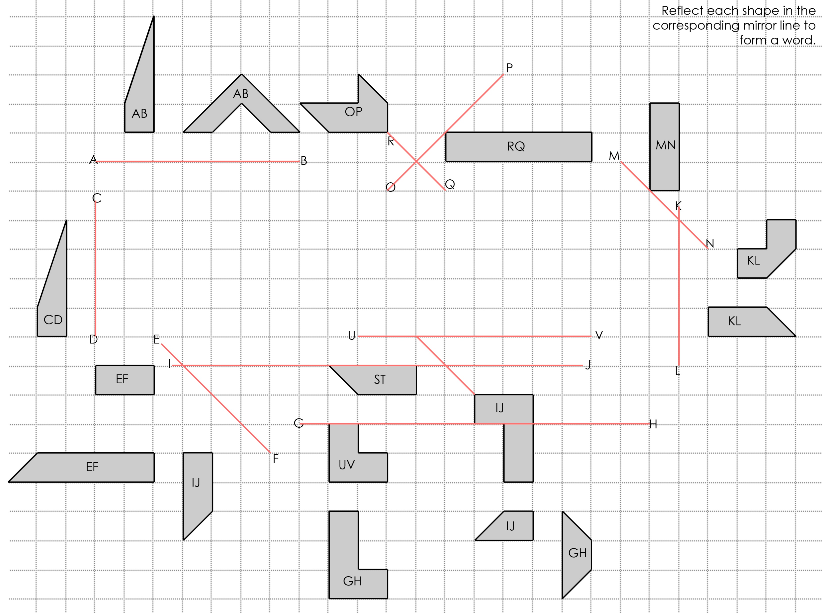
e.g.

Slide 10
This powerpoint was kindly donated to www.worldofteaching.com
http://www.worldofteaching.com is home to over a thousand powerpoints submitted by teachers. This is a completely free site and requires no registration. Please visit and I hope it will help in your teaching.

